Slide 1

NFL machine learning project
EMILY SKOWRONSKI, WADE KEELER, NICK MALLET, DANIEL FERENCE

Slide 2
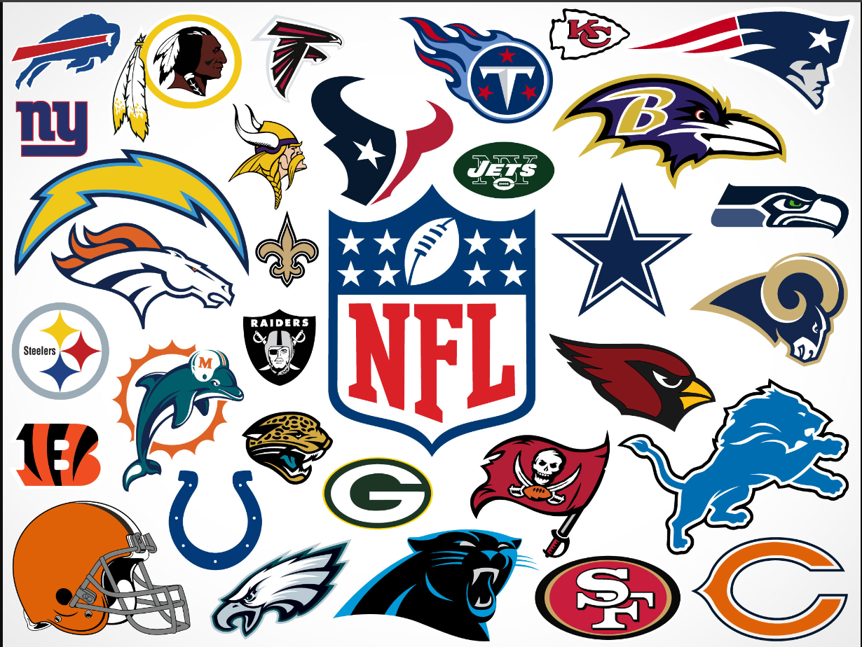
AGENDA
INTRODUCTION
NFL WINS & LOSSES
PHILIDELPHIA EAGLES RECORD
NFC EAST DIVISON WINS & LOSSES
MACHINE LEARNING PREDICITONS

Slide 3
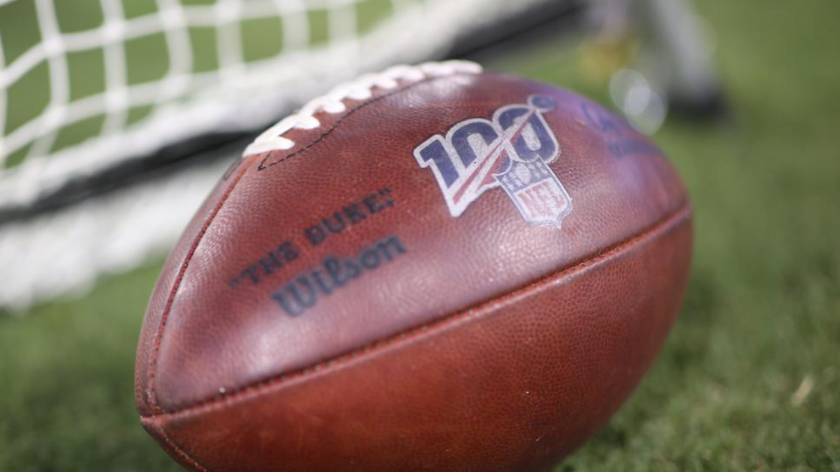
INTRODUCTION
PROJECT QUESTIONS:
HOW CAN MACHINE LEARNING BE APPLIED TO SPORTS BETTING?
HOW DO WE FIT THE MODEL TO WHAT WE WANT TO ACCOMPLISH?
DOES THE MODEL ACCURATELY PERFORM AND WHAT ARE SOME SHORTCOMINGS OF THE MODEL?

Slide 4
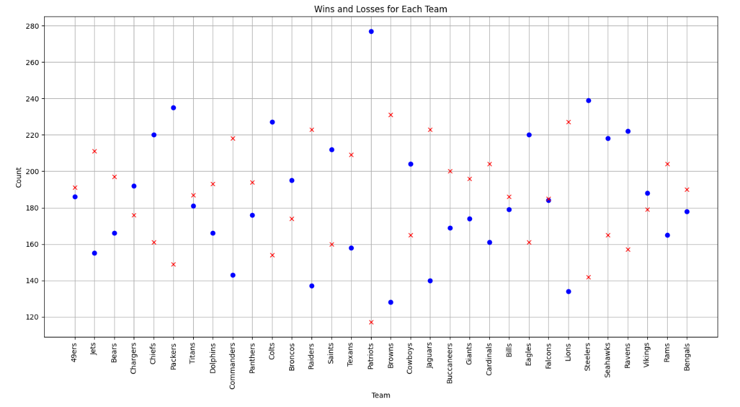
NFL DATA WIN/LOSS RECORDS
Shown are the Win/Loss records of all NFL teams since the expansion to 32 teams in 2002. The data compiled will help the model learn, with the desired outcome being a model that will be able to effectively predict the outcome of a specific NFL game, based on stats from all teams.

Slide 5
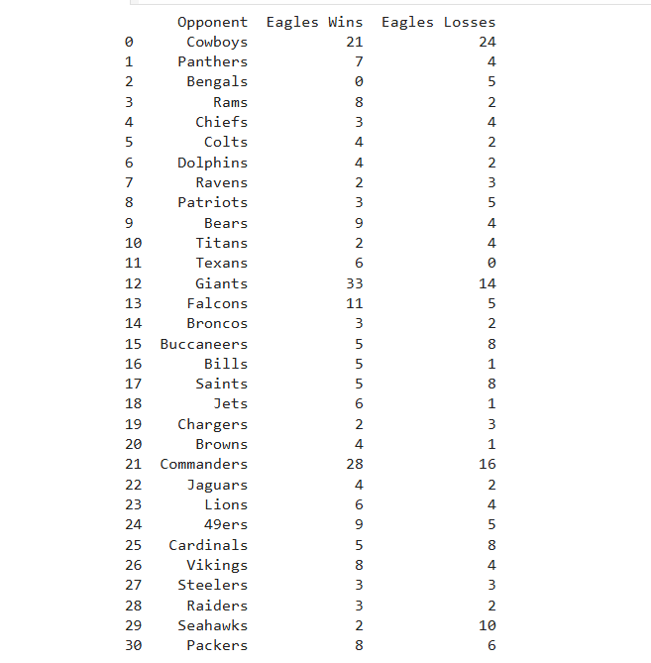

Shown is the Win/Loss record of the Philadelphia Eagles since 2002. This will help to represent past data for our NFL predictions later, given the data compiled, how will the team’s stats impact the model against overall Wins/Losses?

Slide 6
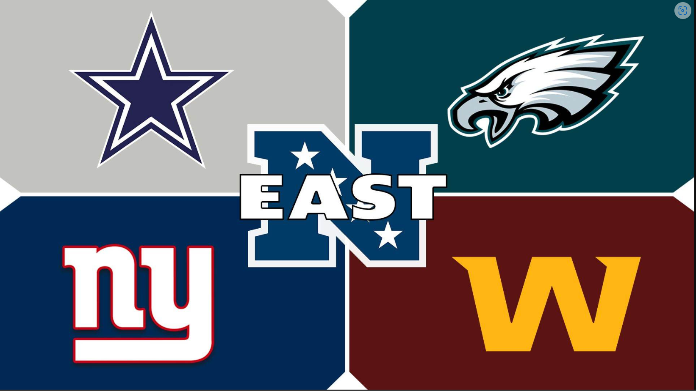
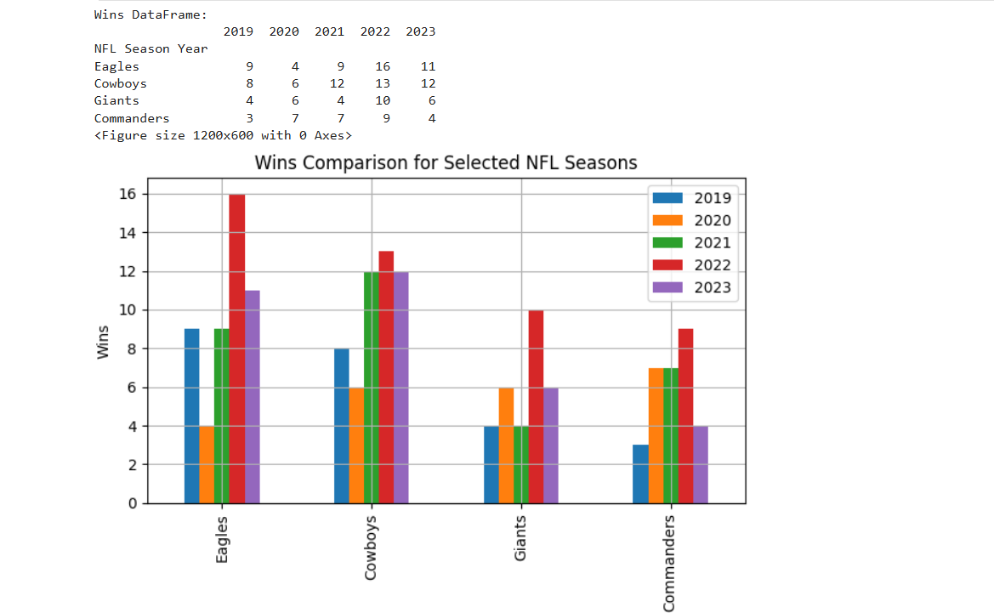
Nfc east division records
Here is the NFC East division record over the past 5 seasons. Will the model create any type of bias from the Win/Loss records, do higher team stats correlate to higher predictions, or can the model take a cumulative viewpoint for all the data without a user weighting scale?

Slide 7

Lets put it to the test….

